Slide 1
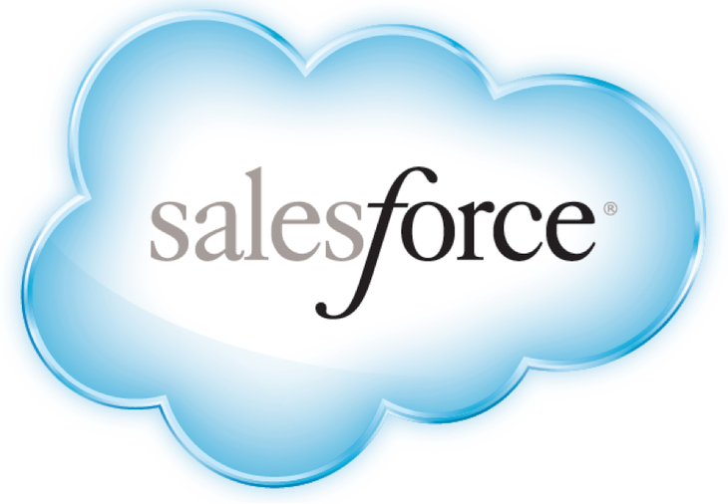
SDO - WORK FORCE OF FUTURE SALESFORCE TRAINING

Slide 2
Fundamentals On Salesforce

Slide 3
Contents
Overview Of Salesforce
Basics of CRM
Advantages of Salesforce
Architecture of Salesforce
Security
Versions in Salesforce
Benefits of lightning over classic
Questions

Slide 4

Overview of Salesforce
Salesforce is the worlds' first and most popular CRM system`& its headquarters is situated in San Francisco
It was founded in March 1999 by former Oracle executive Marc Benioff & Salesforce.com has its services translated into 16 different languages and currently has 100,000 regular customers
Salesforce grew into a cloud software solution and acquired several other companies for Paas(Platform as a Service) and Saas (Software as a Service)
It involves managing all aspects of relationship between an organization and its customers
Beyond the customer related information, it also involves storing and managing the details of the people and the concerned department from the seller organization that is managing the customer’s account and needs.
It helps in creating a flexible approval process with deal discounts and expense management etc.

Slide 5

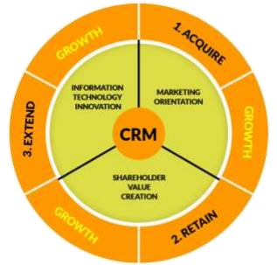
CRM Overview - Purpose
Customer Relationship Management aims in aiding the
power enhancement
CRM helps turn you into an improved informational
organization
Elevating the customer’s communication with CRM
CRM provides an improvised Customer Care Service
CRM adds on in automating everyday tasks
Greater efficiency and stability when it comes to Multiple teams
Excellent analytical data and reporting of the customer

Slide 6
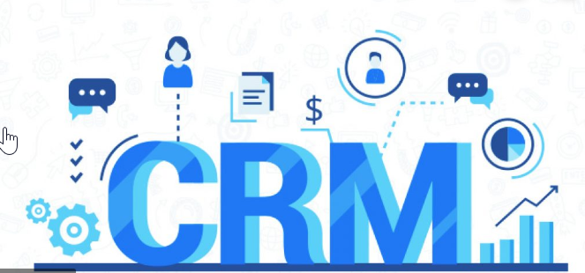
Customer Relationship Management
CRM is a business strategy that aims to understand, anticipate and manage the needs of an organization's current and potential customers.
It is a comprehensive approach which provides seamless integration of every area of business that touches the customer- namely marketing, sales, customer services and field support through the integration of people, process and technology
CRM is concerned with the creation, development and enhancement of individualized customer relationships with carefully targeted customers and customer groups resulting in maximizing their total customer life-time value
The focus is on creating value for the customer and the company over the longer term. When customers value the customer service that they receive from suppliers, they are less likely to look to alternative suppliers for their needs

Slide 7
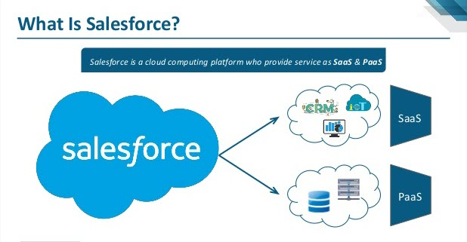
Salesforce Services – SaaS & PaaS

Slide 8
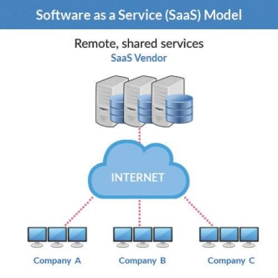
Software as a Service - SaaS
Software as a service (SaaS) is a way of delivering applications over the Internet—as a service. Instead of installing and maintaining software, you simply access it via the Internet, freeing yourself from complex software and hardware management.
Entire company is managed centrally by the software company Inc. infrastructure, network and security.
Interested individuals/companies are allowed to ‘Rent’ it rather than ‘Own’ it
Requires access through a network (Usually internet but can also be accessed through Intranet as well)
Replicates to One to Many Model (single instance, multi-tenant architecture)
No need for clients to worry about patch upgrades and version management as all features are updated automatically

Slide 9
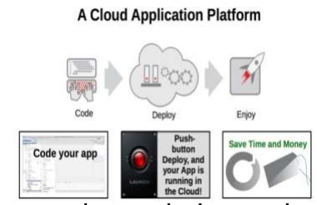
Platform as a Service - PaaS
Cloud computing has evolved to include platforms for building and running custom applications, a concept known as “Platform as a Service” (or PaaS)
Platform as a service (PaaS) is a category of cloud computing services that provides a platform allowing customers to develop, run, and manage applications without the complexity of building and maintaining the infrastructure typically associated with developing and launching an app.
Types of PaaS Solutions:
Social Application Platforms
Web Application Platforms
Business Platforms
Simplified deployment
Lower Risk

Slide 10
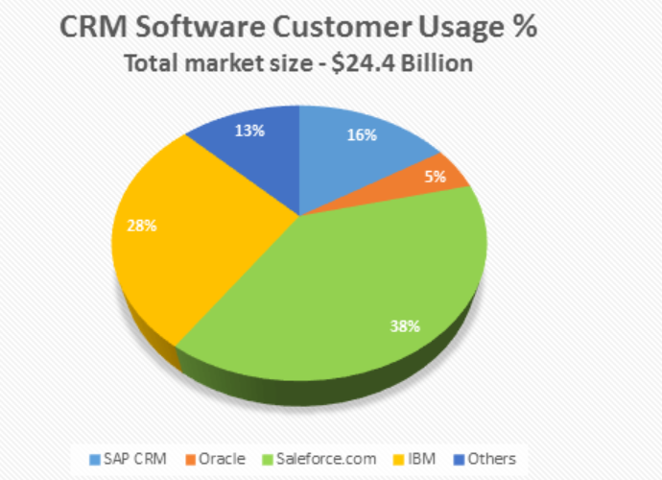
38% of CRM software customers prefer Salesforce CRM over other software solutions.

Slide 11
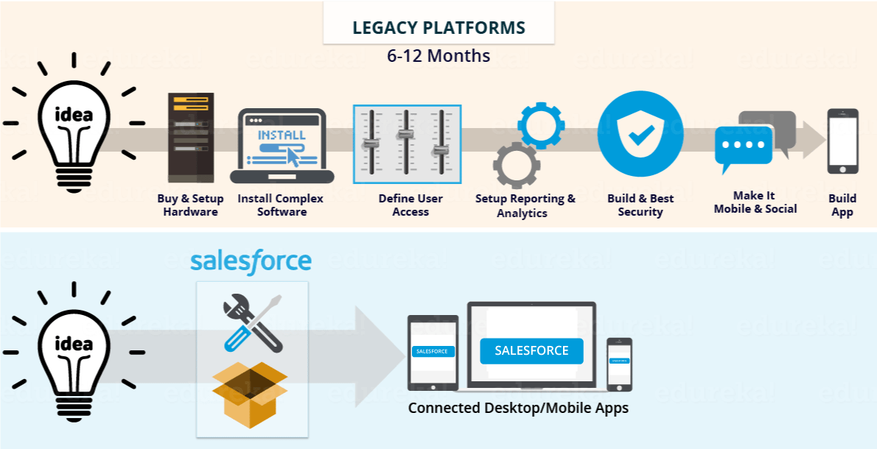
Why Salesforce?

Slide 12
Advantages of Salesforce
Excellent Functionality
Salesforce delivers with an outstanding system of integration and functionality
It allows easy data collaboration between multiple departments and the ability to run on any browser, tablet, desktop, or mobile device.
Flexibility and Customization
Salesforce allows companies to measure and monitor the success of their marketing campaigns and to customize these outreach efforts on an on-going
Greater Efficiency for Multiple Teams
Automatically stored communication allows you to view emails, calendar, and phone call details in one easily accessible place.
Ease of Use
It stands to reason that one of the single most important elements of any service is its ease of use
Unlike other applications, there is no need to get involved with coding or to carefully pour through information about product updates. Instead everything is served up in an easy-to-understand format designed to minimize difficulty and inconvenience
App Exchange
This marketplace of easy to access, download, and install apps provides users with even more resources, options, and expanded functionality.

Slide 13
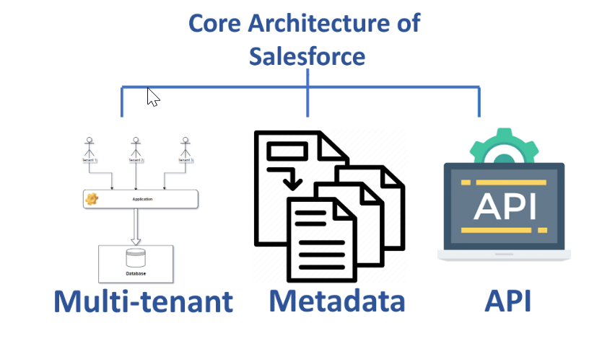
Architecture

Slide 14
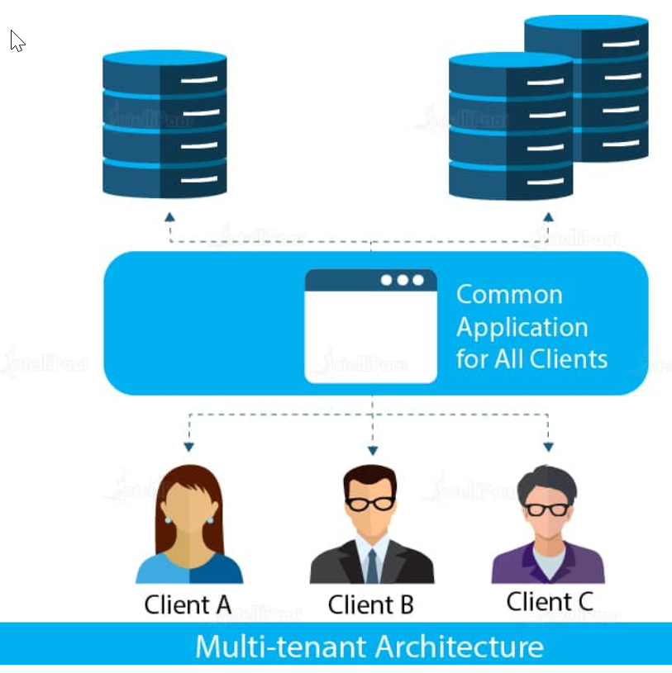
Multi - Tenant
All data is stored in a single database schema for all their customers.
It is economical because resources and maintenance are shared.
A single instance of a software server with multiple tenants.
The provider has to update only one application, and the changes will get updated for all clients.
Comparing this with the single-tenant architecture, each client will be owning one particular software/application. So in the single-tenant architecture, the development and maintenance cost has to be completely owned by one particular client.

Slide 15
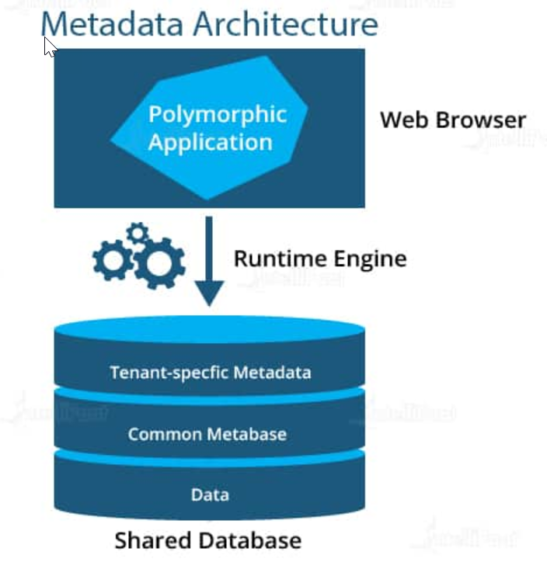
Metadata
Salesforce platform uses a meta-driven development model
Developers need to concentrate only on building the application
Functionalities of an app are defined as metadata in a database
This increases developers’ productivity
The issues of security get sorted with this particular architecture, since all the data is stored on different levels. All the data is stored in shared databases; the metadata points to one particular clients’ data in a shared database.
Consider, three clients, A, B, and C, sharing a single database. So, each client will have access to their own metadata from the shared data. So, each client will have separate metadata. This ensures that you don’t get into someone else’s metadata.

Slide 16
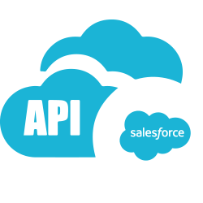
API
A powerful source of APIs is provided by Salesforce.
Salesforce provides programmatic access to your organization's information using simple, powerful, and secure application programming interface
These APIs help in the development and customization of Salesforce Mobile Application.
These APIs enable diverse bits of programming to interface with each other and trade data.
These APIs are comparable.
Without knowing much details, you can connect your apps with other apps.

Slide 17
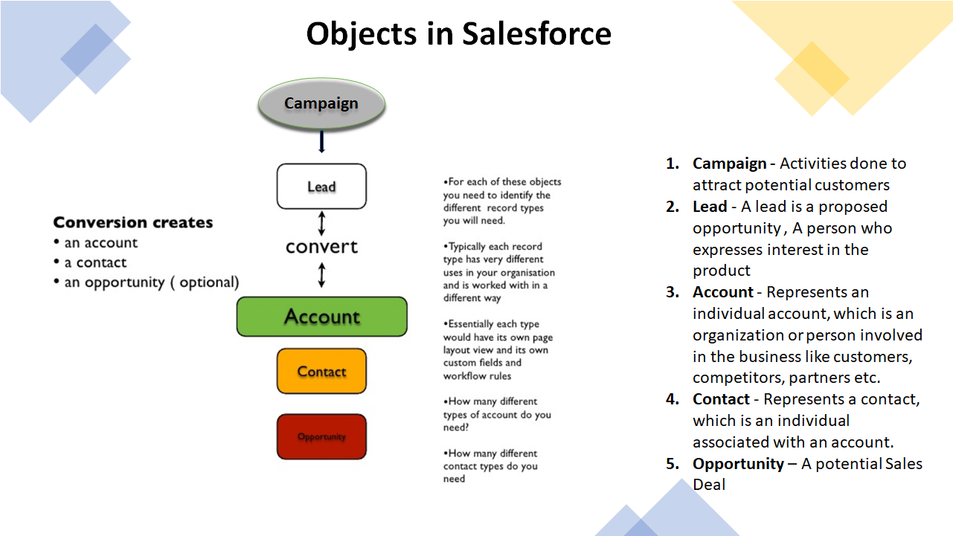

Slide 18
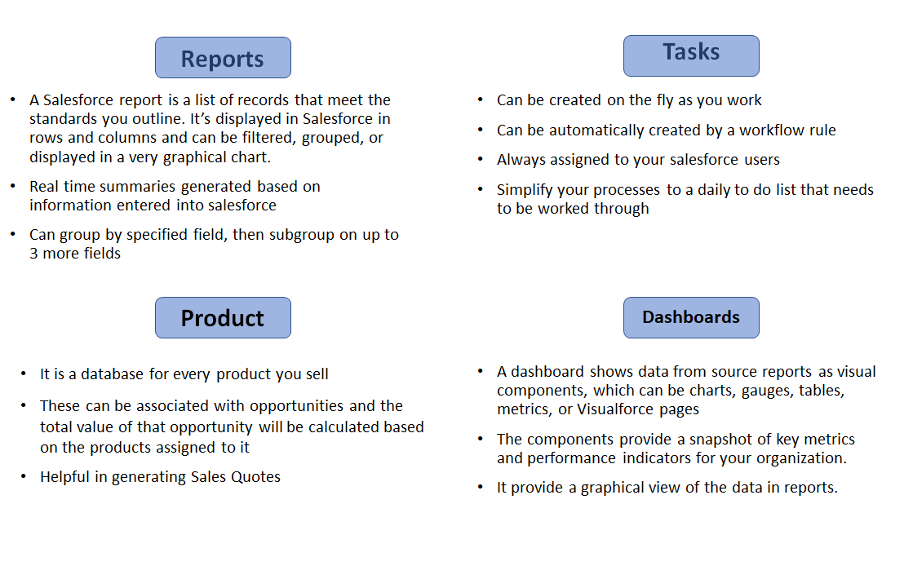

Slide 19
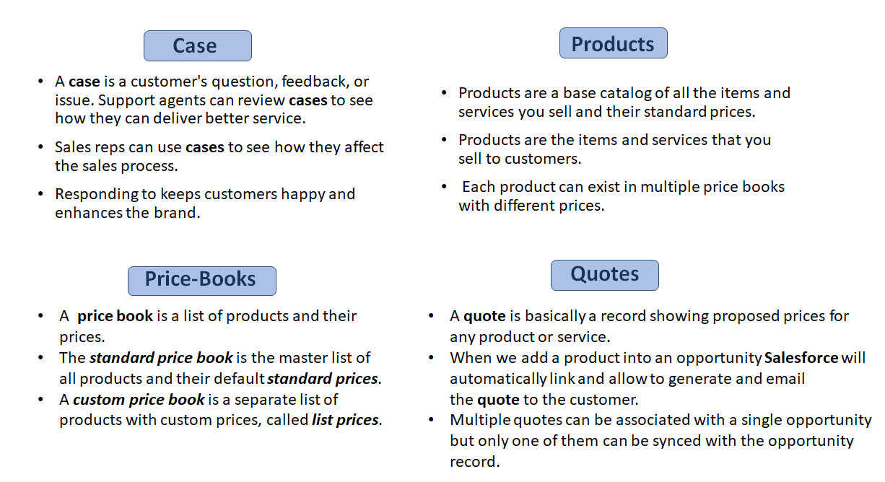

Slide 20
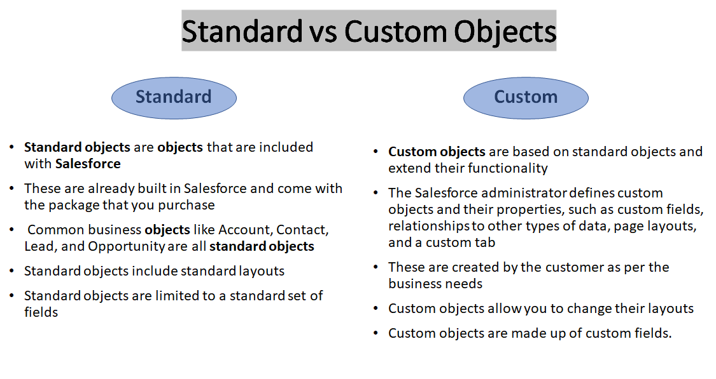

Slide 21
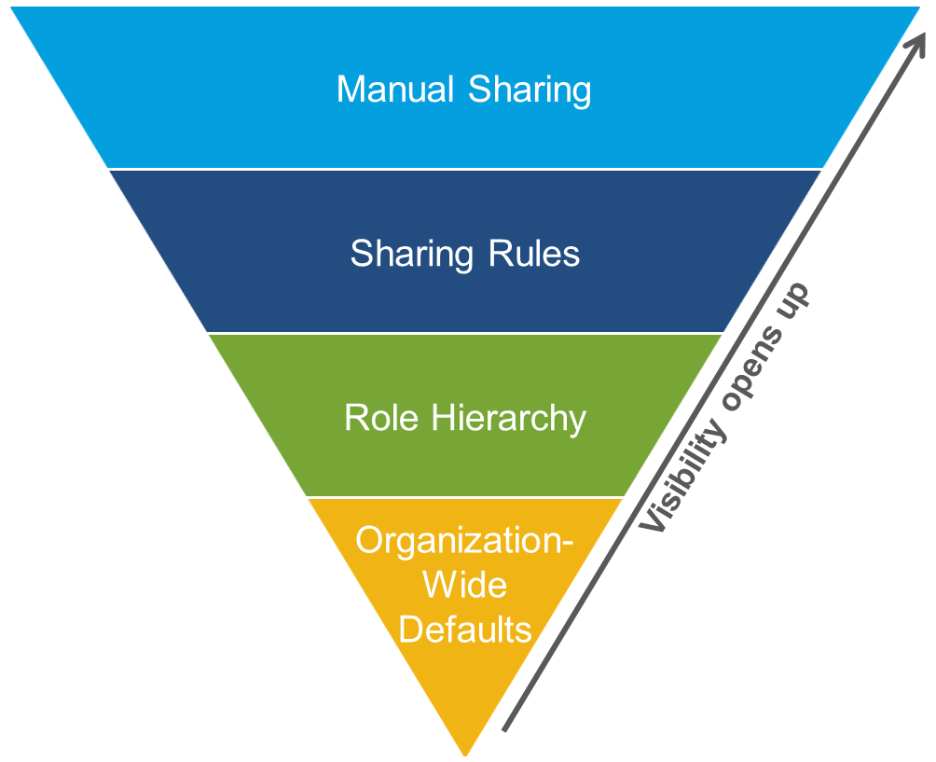
Security
To control data access precisely, you can allow particular users to view specific fields in a specific object, but then restrict the individual records they're allowed to see
This can be done in 4 ways:
Org-wide defaults specify the default level of access users have to each other’s records.
Role hierarchies ensure managers have access to the same records as their subordinates.
Sharing rules are automatic exceptions to org-wide defaults for particular groups of users, to give them access to records they don’t own or can’t normally see.
Manual sharing lets record owners give read and edit permissions to users who might not have access to the record any other way.

Slide 22
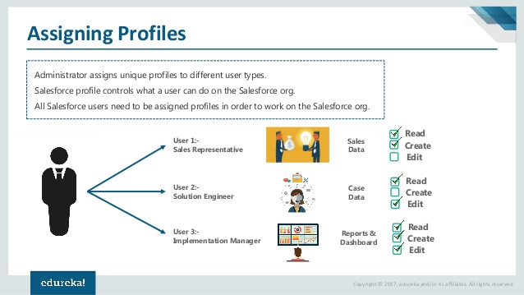
Profile
A profile in Salesforce is a group/collection of settings and permissions that define what a user can do in Salesforce.
A profile controls “Object permissions, Field permissions, User permissions, Tab settings, App settings, Apex class access, Visualforce page access, Page layouts, Record Types, Login hours & Login IP ranges.
A profile can be assigned to many users, but a user can be assigned a single profile at a time.
You can define profiles by user’s job function. For example System Administrator, Developer, Sales Representative.

Slide 23
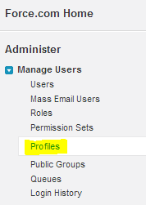
Types Of Profile
Standard profiles:
By default, salesforce provides below standard profiles. We cannot delete standard ones.
Read Only, Standard User, Marketing User, Contract Manager, Solution Manager & System Administrator.
Each of these standard ones includes a default set of permissions for all of the standard objects available on the platform.
Custom Profiles:
Custom ones defined by us. They can be deleted if there are no users assigned to that particular one.
Navigation:
setup -> Administer -> Manage users -> Profiles

Slide 24
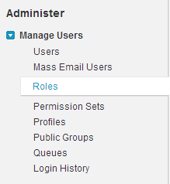
Role Hierarchy
Role Hierarchy controls the level of visibility that users have to an organization data.
By defining role hierarchies, we can share access to records.
Users assigned to roles near the top of hierarchies like (CEO, executives, and other higher level roles) get to access the data of all users who fall directly below them.
Role hierarchies enable the following behaviors:
Managers will always have access to the same data as his or her employees, regardless of the org-wide default settings. For custom objects, you can override this behavior by deselecting the Grant Access Using Hierarchies check box.
Users who tend to need access to the same types of records can be grouped together
Navigation:
Setup -> Administer -> Manage users -> Roles

Slide 25
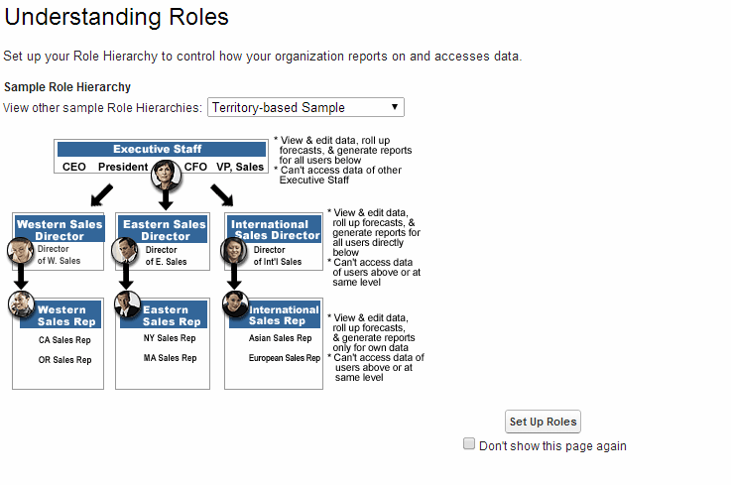
Role Hierarchy

Slide 26
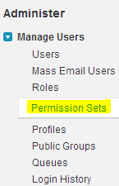
Permission Sets
Permission set is similar to profile.
Whatever user can manage at profiles (Like Object permissions, Field Permissions, User permissions, Tab settings, App settings, Apex class permission, visual-force permission) the same can be managed here too.
Major difference between these two are user can have only one profile and can have multiple permission sets at a time.
Examples:
1. We have many users in your organization with some fundamental job functions. We can assign all of then with one profile that grants them all access to do their job. But some set of people are working on special apps or some special functionality, for this type of special users we can create permission sets and can be assigned to them.
2. Some users need some temporary access to a specific set of fields and objects we can create a permission set with those object & field access and we can assign those specific users.
Navigation:
Setup -> Administer -> Manage users -> Permission sets

Slide 27
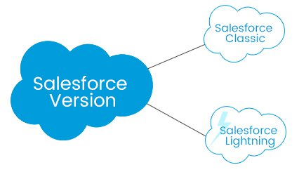

Versions
Salesforce Classic:
First version of Salesforce which was the standard stage which was utilized for
quite a while
It is likewise important to change the UI to make it easier to use and perfect it
with the most recent innovation
Salesforce Lightning:
Salesforce lightning is a refreshed form of Salesforce Classic and it incorporates Lightning component framework with extra
apparatuses for developers which makes it intelligent.

Slide 28
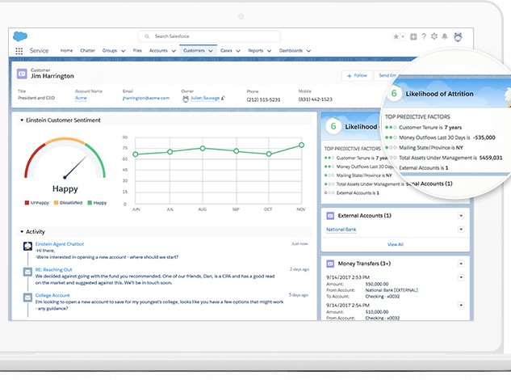
Einstein AI enabled view
With Einstein AI you can:
• Build custom predictions and recommendations with clicks • Embed predictive insights into any record or in any app • Operationalize AI by adding it to every workflow or business process

Slide 29
Einstein AI Features in Salesforce
Identify significant patterns and trends you can act on.
Understand your customers in a whole new way.
Embed AI-powered assistance right where it’s needed.
Know more and guess less with Einstein AI.
Impress every customer with a personalized experience.
Anticipate customer actions based on their behaviors.

Slide 30
Benefits of Lightning over Classic
New design for ease of use: Salesforce Lightning has a cutting edge, effective and keen interface. All clients can interface with their records over any gadgets. The asked for data is surfaced for every last one of them. That guarantees the streamlined procedure and makes work processes progressively instinctive
Smarter views: This element can assist clients with focusing on the more vital things first. Basically, data will be shown all the more powerfully and outwardly.
More columns on dashboards: The dashboards are not confined to three segments. The segments are vivified and permit to get more information-driven choices initially. The clients can see open/close sales amounts just as the closed ones.
Home Page: It can be altered and show essential data at first to assist you with being progressively effective. In addition, it very well may become to wherever you have to see the late assignments, leads, openings, and potential issuers.
Activity Timeline: This workspace empowers you with making the assignments and occasions, log calls, send messages and track these exercises proficiently. Likewise, the Lightning background doesn't require the refreshment of the whole page for sparing the updates.
Opportunity Kanban: This feature has been included as a representation instrument for circumstances. The reps can survey the arrangements at each phase in the pipeline. The intuitive usefulness offers you to move bargains starting with one phase then onto the next.
Lightning Experience: This version is commonly accessible for all the editions at no extra expense.

Slide 31








Salesforce Applications
Salesforce Sales Cloud
Salesforce Commerce Cloud
Salesforce Marketing Cloud
Salesforce App Cloud
Salesforce Service Cloud
Salesforce IoT Cloud
Salesforce Community Cloud
Salesforce Health Cloud

Slide 32
Questions?

Slide 33

Thank You ☺

